Slide 1
Ansible

Slide 2
Configuration Management
Configuration management encompasses the practices and tooling to automate the delivery and operation of infrastructure. Configuration management solutions model infrastructure, continually monitor and enforce desired configurations, and automatically remediate any unexpected changes or configuration drift. By enabling you to deliver better software faster, configuration management helps lay the foundation for DevOps.

Slide 3
The Process Of Configuration
Configuration identification — The configuration that needs to be maintained first must be identified. It can either be a manual process, such as maintaining the source code on a common repository or using discovery tools to automatically identify the configuration.
Configuration control — Once the configuration items are identified, there is no guarantee that it will remain unchanged. In all probability, the configuration is likely to change. Thus, there needs to be an effective mechanism to control the changes that go into the configuration management system. In most configuration management frameworks, the change management process acts as a guardian for controlling the changes to the configuration management system.
Configuration audit — Despite there being control mechanisms protecting against changes in configuration, means of bypassing exist. Therefore, configuration audits are necessary to keep an eye on configuration compliance.

Slide 4
Devops Starts And Ends With Configuration
Yes, it is true that you cannot really do DevOps without configuration management in place. configuration management, without which the artifacts and other useful information will be all over the place, and in a disorganized manner.
Remember the objective of DevOps — developing software as quickly as possible. This objective can only be done through proper organization and planning, and the comprehensive configuration management gives you sufficient ammo to power up the DevOps machine.
For this reason, configuration management professionals are in great demand. Every project throws new challenges in my direction, thus heralding new findings and learnings. For me, this is the beauty of configuration management.

Slide 5
History of CM
mid-1990s – “snowflake system”; few systems
Rise of Unix-like systems and commodity x86 hardware increased the need
CFEngine – First release 1993; v2 released in 2002
mid-2000s through present
More agile CM systems emerged developed with the cloud in mind
2008
provisioning and management of individual systems were well-understood

Slide 6
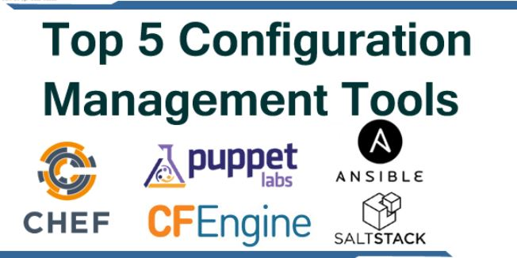

Slide 7
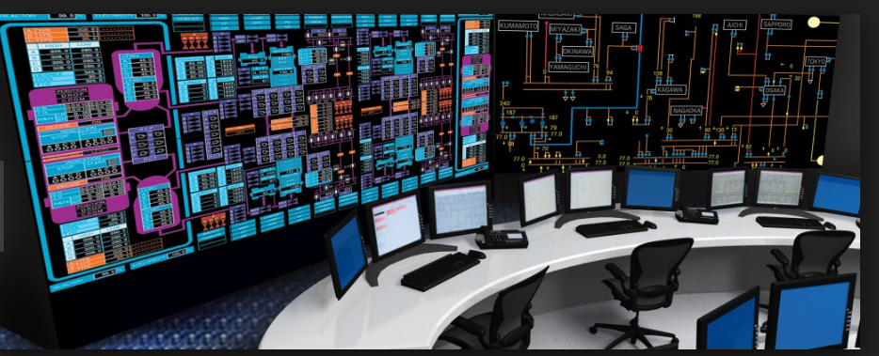

What is Ansible ????

Slide 8
Why Ansible ????
Change Management
Provisioning
Orchestration
Automation

Slide 9
Change Management
Define the state of the system and enforce it.
Apache Installed
Apache version xxx
Service - Started

Slide 10
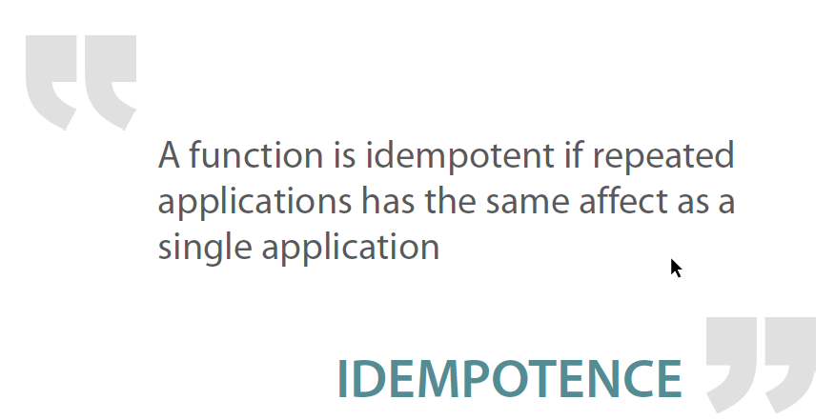

Slide 11


Slide 12
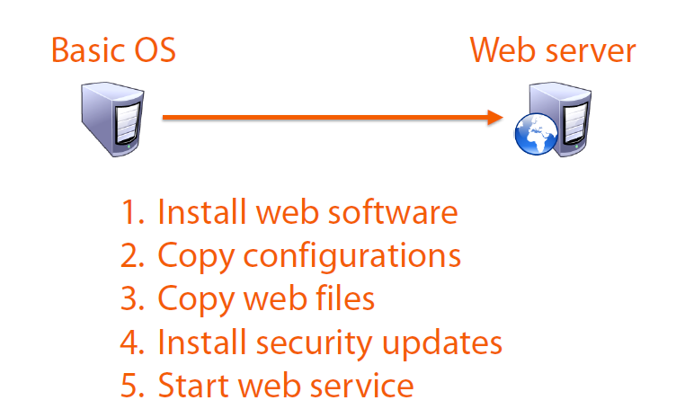
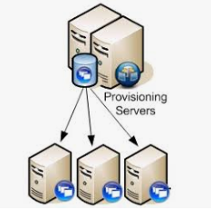
Provisioning

Slide 13


Automation
Define the requirement.. Write the instructions…..

Slide 14
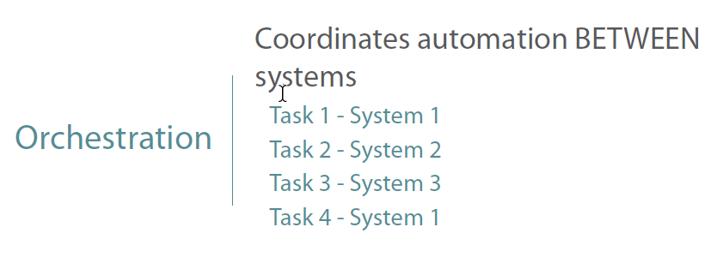
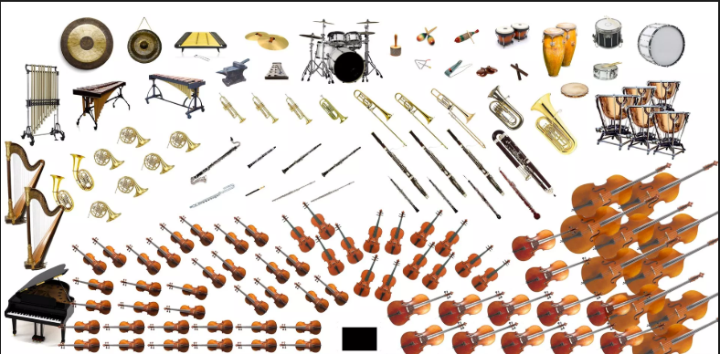

Slide 15
Why Ansible
SIMPLE
Human readable automation
No special coding skills needed
Tasks executed in order
POWERFUL
App deployment
Configuration management
Workflow orchestration
AGENTLESS
Agentless architecture
Uses OpenSSH and WinRM
No agents to exploit or update
Reliable and secure

Slide 16
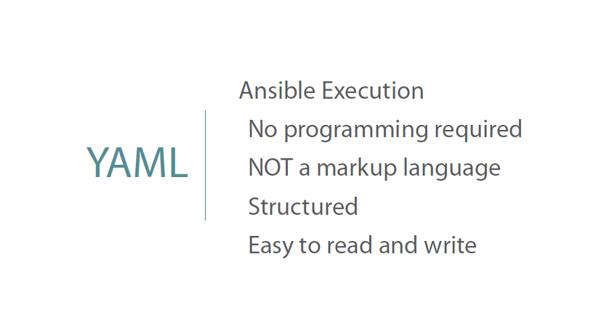
YAML (YAML Ain't Markup Language) is a human-readable data serialization language. It is commonly used for configuration files, but could be used in many applications where data is being stored (e.g. debugging output) or transmitted (e.g. document headers).
YAML targets many of the same communications applications as XML but has a minimal syntax which intentionally breaks compatibility with SGML .[1] It uses both Python-style indentation to indicate nesting, and a more compact format that uses [] for lists and {} for maps[1] making YAML 1.2 a superset of JSON.[2]
Source : wiki

Slide 17
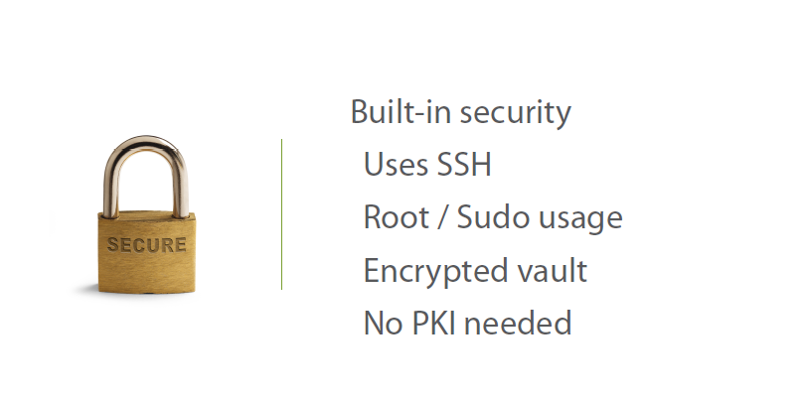

Slide 18
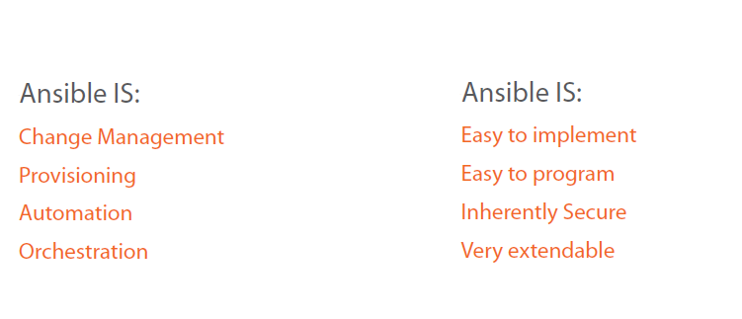

Slide 19
Let us INSTALL!!!!

